Slide 1
Web 3.0 Testing using Hardhat
Muhammad Hammad - l192371
Muhammad Mahir - l191234
Mahad Chaudhary - l191109
Group-24

Slide 2
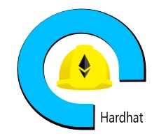
What is Hardhat?
Ethereum development environment
facilitates performing frequent tasks
Deploying and running tests on smart contracts
automatically checking code for mistakes
Interacting with smart contracts

Slide 3
Writing Automated Smart Contract Tests
Steps to follow:
Write smart contract using solidity
Compile the contract using hardhat runner.
Write tests
Deploy the contract on live Network

Slide 4
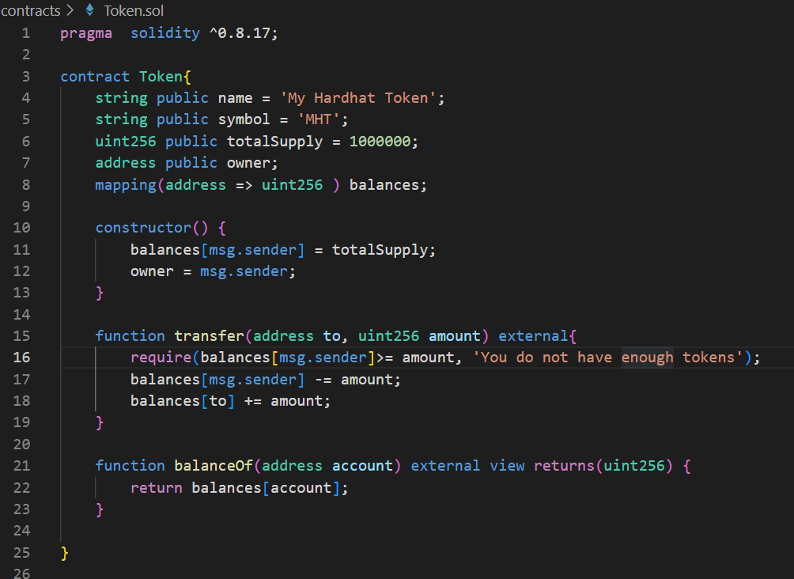
Writing a Contract

Slide 5
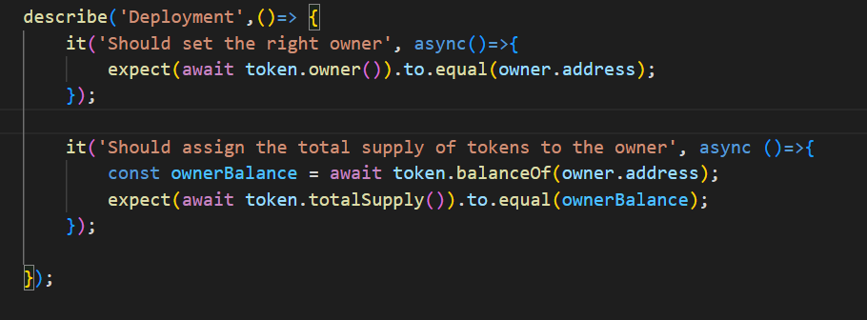
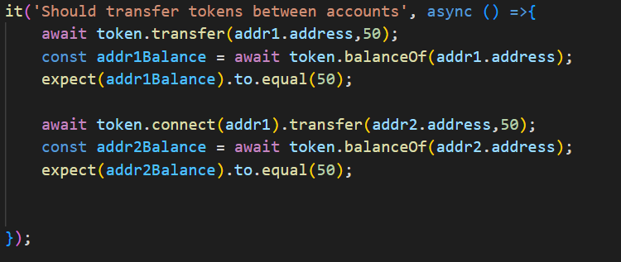
Testing a Contract

